Slide 2
Simulating Dice With Python on the TI-Nspire™ CX II Graphing Calculator
Chris Atkinson

Slide 3








Chat
Join the chat and engage with other audience members.
Platform help
Get help using the ON24 Platform with technical guides, user resources, FAQs
and more.
Session Q&A
Ask your presenter a question at any time during the session.
TI Tech Support
Questions about TI technology? Contact
TI-Cares™ customer support for answers.
Presentation
View the presentation slides for
your session and follow along with
the presenter.
Contact your TI rep
Connect with your local Educational Technology Consultant for help with choosing and implementing TI technology for your classrooms.
Resources
Find the resources related to your session, including files, downloads, URLs and more.
Survey
Provide your feedback about this session. Session surveys can be completed at the end of each session.

Slide 4
Input / Output

Slide 5
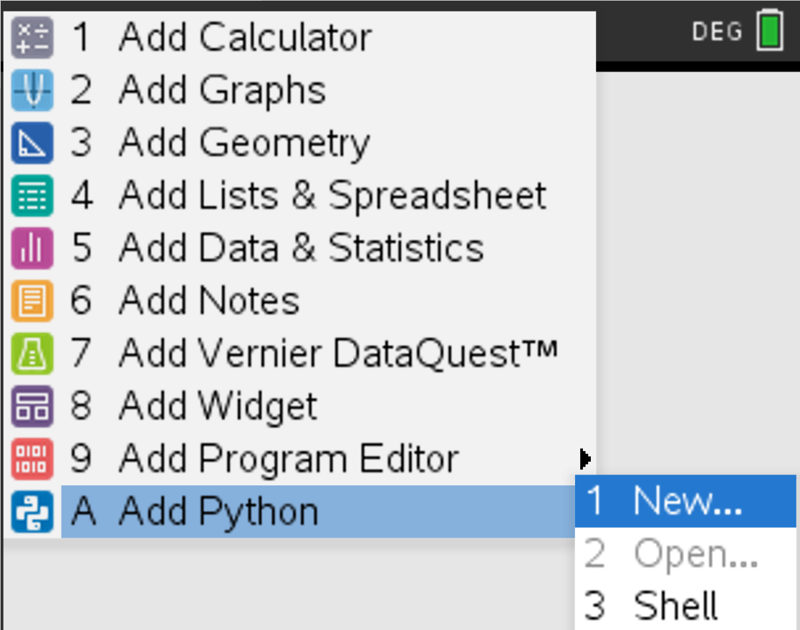
Creating Our Python Program
Home-> A Add Python -> 1 New

Slide 6
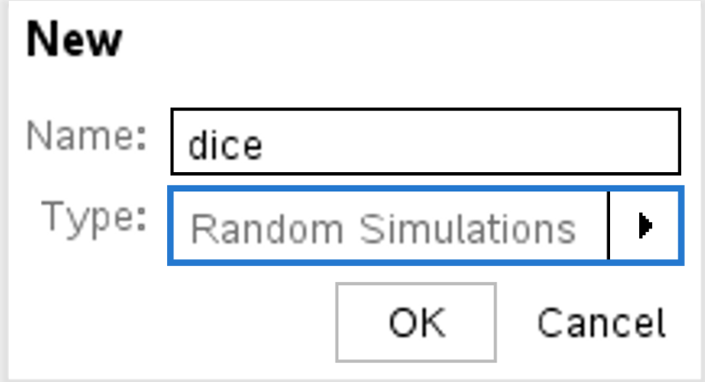
Creating Our Python Program
Give the program a name and select Random Simulations for the Type

Slide 7
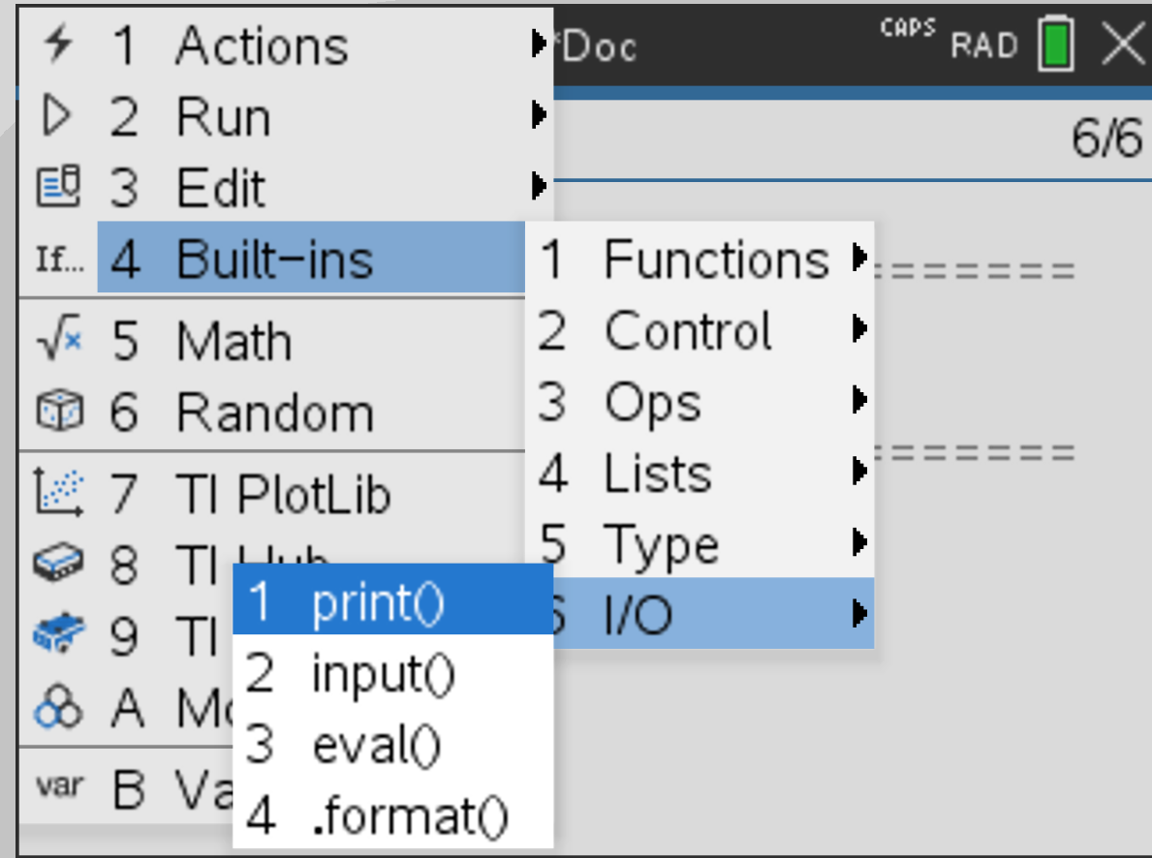
Output Something
Menu -> 4 Built-ins -> 6 I/O -> 1 print()

Slide 8
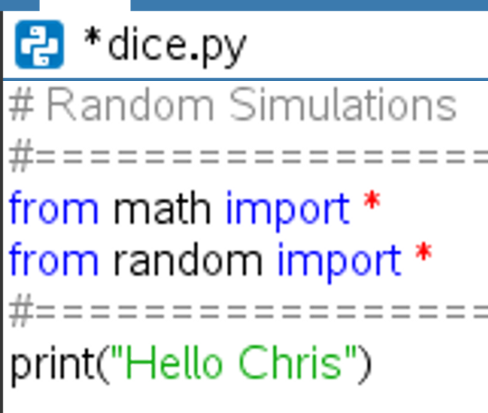
Output Something
print(“Hello #YOUR NAME#”)

Slide 9
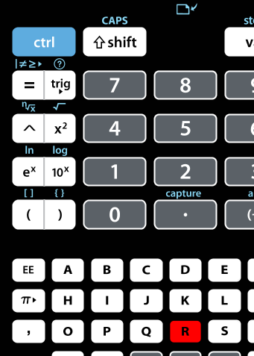
Run the code
CTRL-R

Slide 10
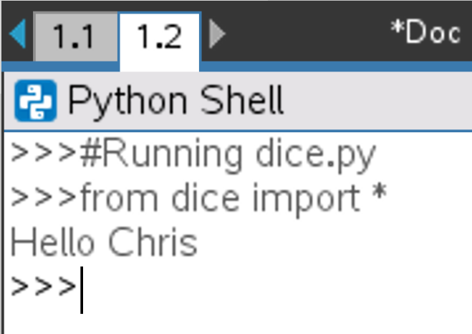
New Python Shell
You should see a new python shell appear with the result of your running code

Slide 11
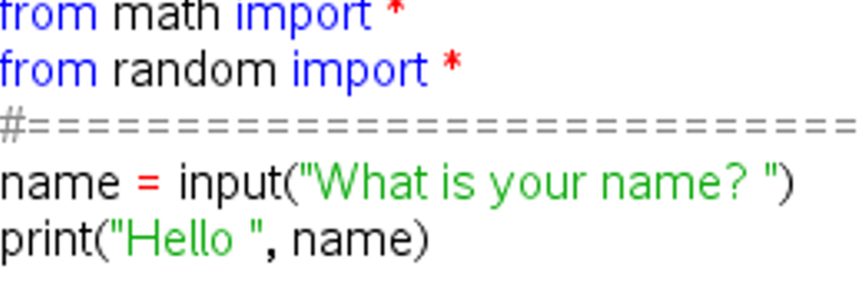
Output Something More Interesting
Collect the user’s name and welcome them
Menu -> 4 Built-ins -> 6 I/O -> 2 input()

Slide 12
Run the code
CTRL-R

Slide 13
Randomness

Slide 14
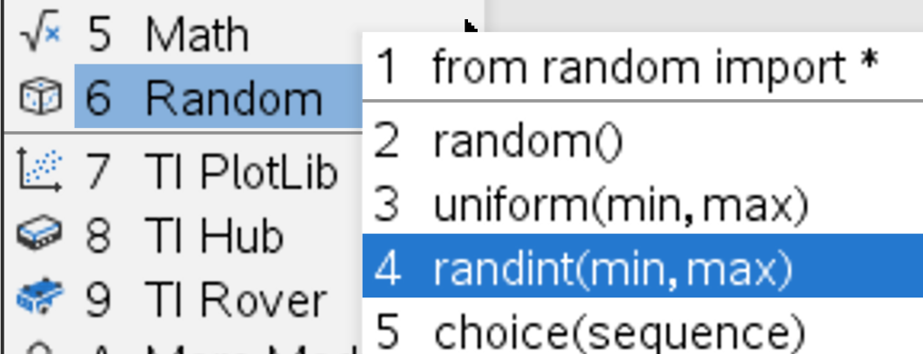
Generate a Random Number
Menu -> 6 Random -> 4 randint(min,max)
Notes:
Start on a new line below your commented out code
CTRL-T OR Menu -> Edit -> 3 Comment/Uncomment

Slide 15
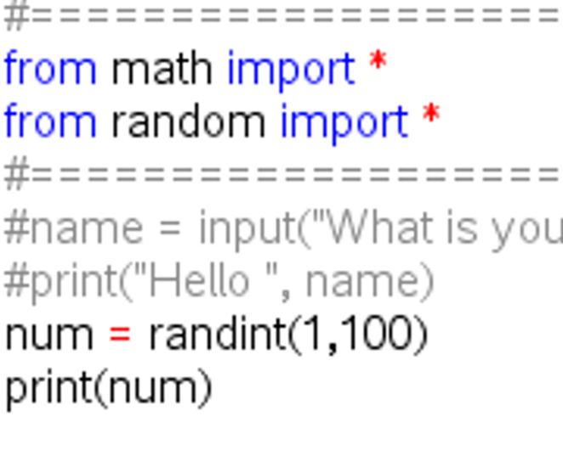
Generate a Random Number
Assign your random number between 1 and 100 to a variable and print that number

Slide 16
Run the code
CTRL-R

Slide 17
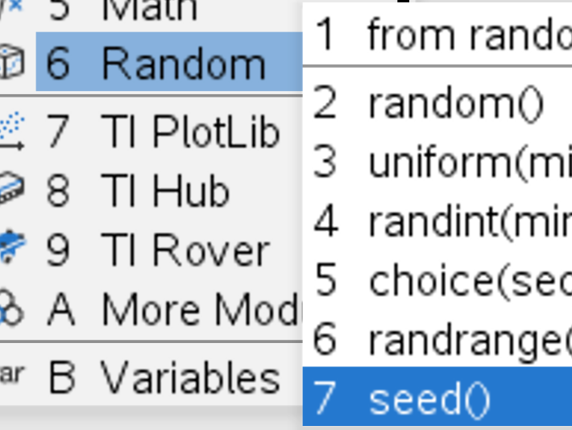
Random Seed
Menu -> 6 Random -> 7 seed()
Notes:
Insert a blank line above your random number assignment

Slide 18
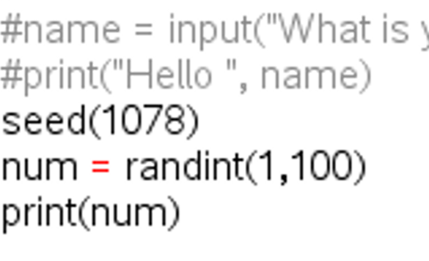
Random Seed
Use any random integer to seed your program

Slide 19
Run the code
CTRL-R

Slide 20
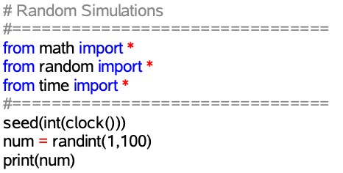
Quirks of Randomization
Repeated running of the code will yield the same results. You may need to randomize even your seed.
Notes:
If a seed isn’t randomized, then you get the same sequence of random digits with each execution of the code. Consider ways to randomize the seed value with a combination of user input and random numbers. Highlight the difference between strings and variables in the print statement and how they are different colors. Also highlight the importance of quotation marks opening and closing.

Slide 21
Run the code
CTRL-R

Slide 22
For Loops

Slide 23
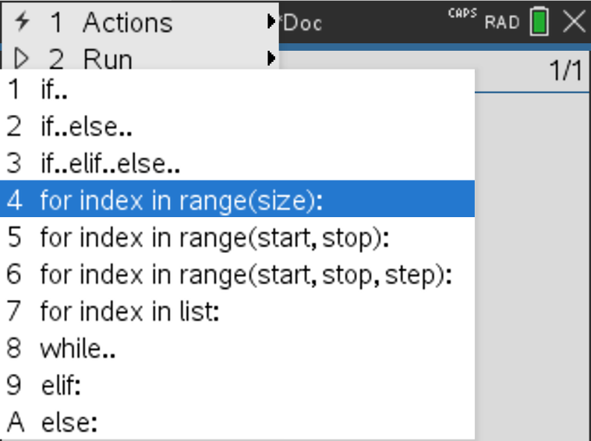
Control Structures (Loops)
Menu -> 4 Built-ins -> 2 Control -> 4 for index in range(size)

Slide 24
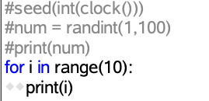
Control Structures (Loops)
Print the first 10 values

Slide 25
Run the code
CTRL-R

Slide 26
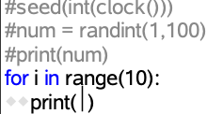
Control Structures (Loops)
Modify your code to print 1 through 10
Modify your code again to print 10 through 1

Slide 27
Control Structures (Loops)
Modify your code to print 10 random numbers
Modify your code again to ask the user how many random numbers they want

Slide 28
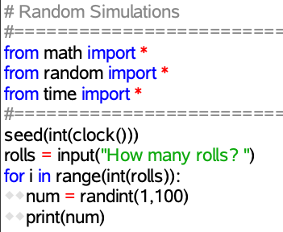
Control Structures (Loops)
Possible Solution
Notes:
Introduce the code to roll the dice inside of a for loop. Highlight the importance of tabbing the code over two spaces that will be run inside the loop.
NOTE: THIS CODE WILL FAIL. Input is received as a string and needs to be cast to an integer. We will do that in the next slide.

Slide 29
Die Rolls

Slide 30
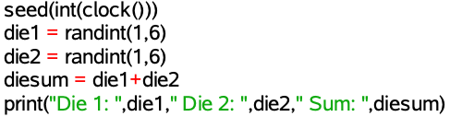
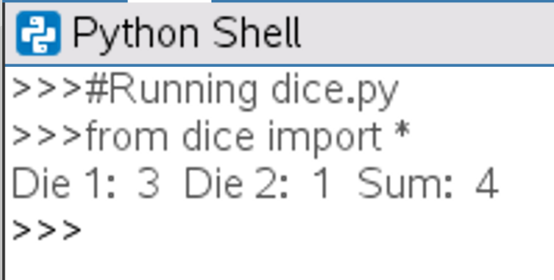
Roll Two Die
Menu -> 6 Random -> 4 randint(min,max)
Store results in variables die1, die2 and the sum in diesum
Notes:
Stop to give students a chance to produce the desired output in the shell pictured on this slide. There are multiple ways of getting here, but one example is shown above

Slide 31
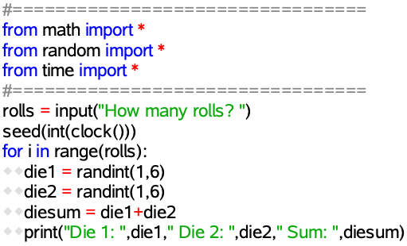
Repeated Rolls of a Die
Use what you learned about For Loops to roll the die 10 times
Use what you learned about User Input to roll the die x times
Notes:
Introduce the code to roll the dice inside of a for loop. Highlight the importance of tabbing the code over two spaces that will be run inside the loop.
NOTE: THIS CODE WILL FAIL. Input is received as a string and needs to be cast to an integer. We will do that in the next slide.

Slide 32
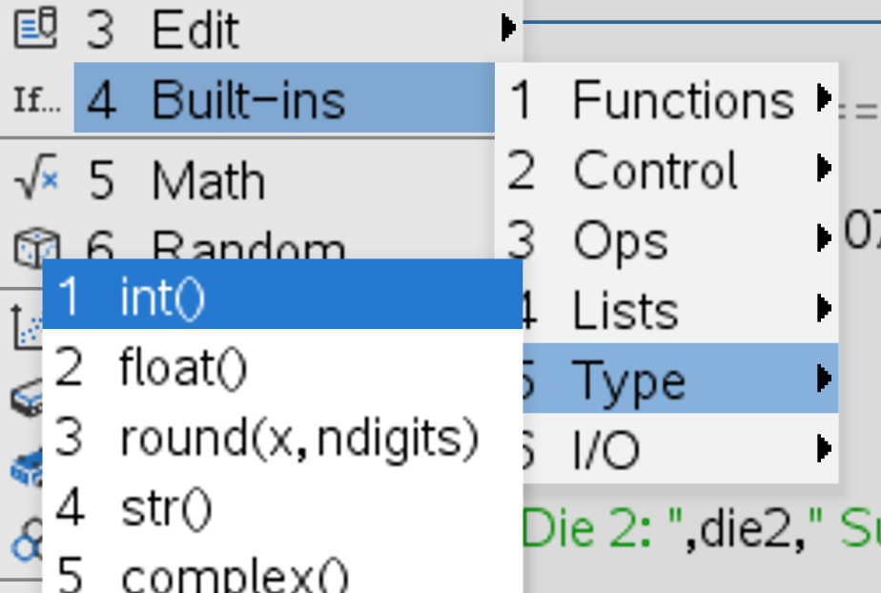
Type Casting
Basically...make user input a number
Menu -> 4 Built-ins -> 5 Type -> int()

Slide 33
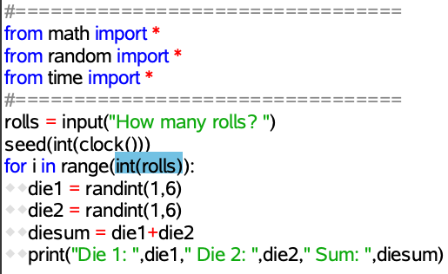
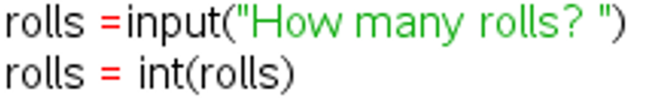

Type Casting
Basically...make user input a number
Notes:
Make sure everyone is caught up at this point.

Slide 34
Store Lists

Slide 35

Collect the Data
Start with an Empty List/Array
Menu -> 4 Built-ins -> 4 Lists -> 1 []
Notes:
Insert new blank line just before the for loop to create your new empty list on.

Slide 36
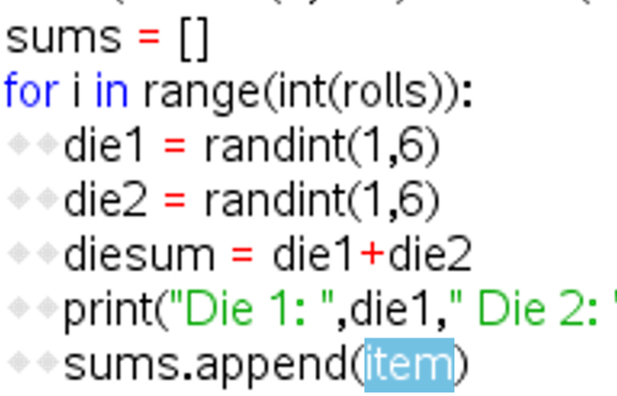
Collect the Data
Add to the list with each Die Roll
Menu -> 4 Built-ins -> 4 Lists -> 6 .append()
Notes:
Insert new line inside for loop at the end of the loop to append the data to the list

Slide 37
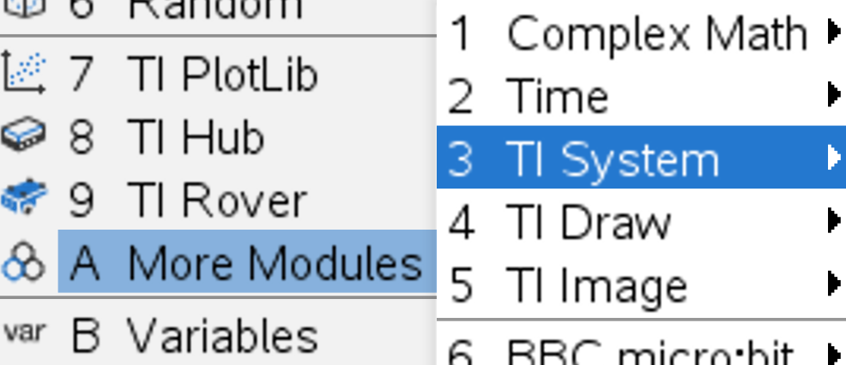
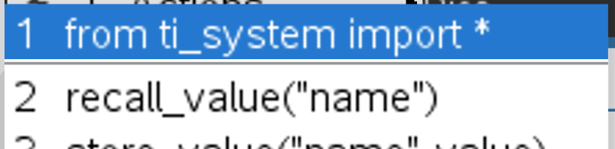
Share the Data
Store/Save/Share the data
Menu -> A More Modules
-> 3 TI System
-> 1 from ti_system import *
Notes:
Insert a new blank line after the first two import statements for this third import statement.

Slide 38
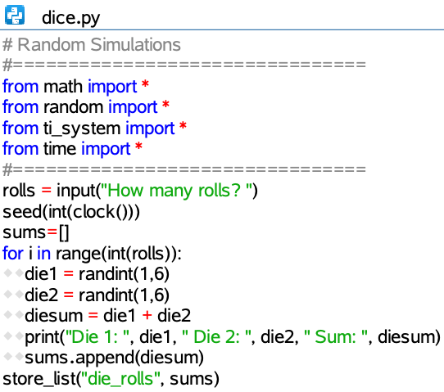
Share the Data
Store/Save/Share the data
Menu -> A More Modules
-> 3 TI System -> 5 store_list(“name”,list)

Slide 39
Run the code
CTRL-R

Slide 40
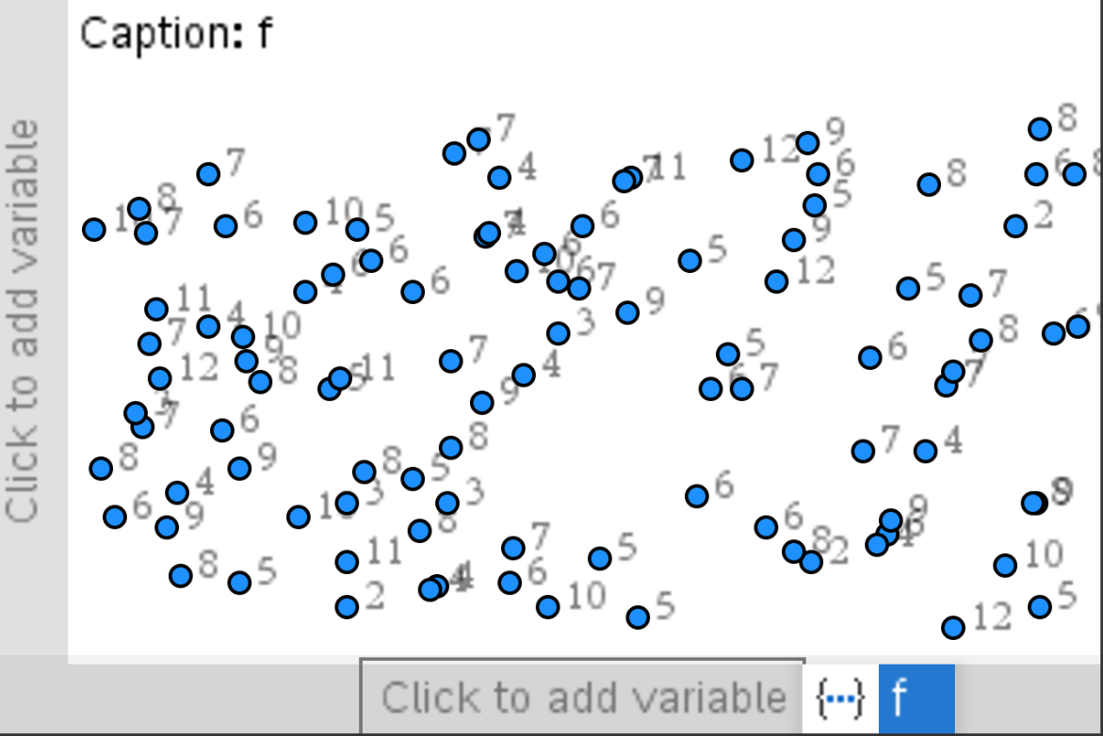

Analyze the Results
Home -> ->Data and Statistics

Slide 41
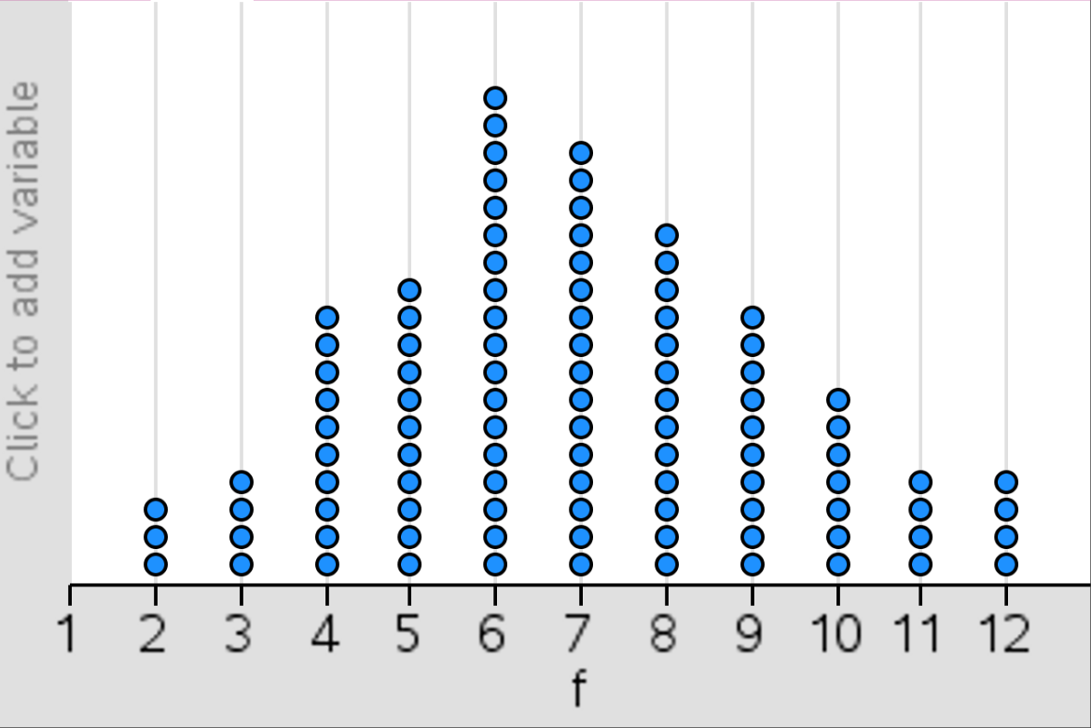
Analyze the Results
Home -> ->Data and Statistics

Slide 42
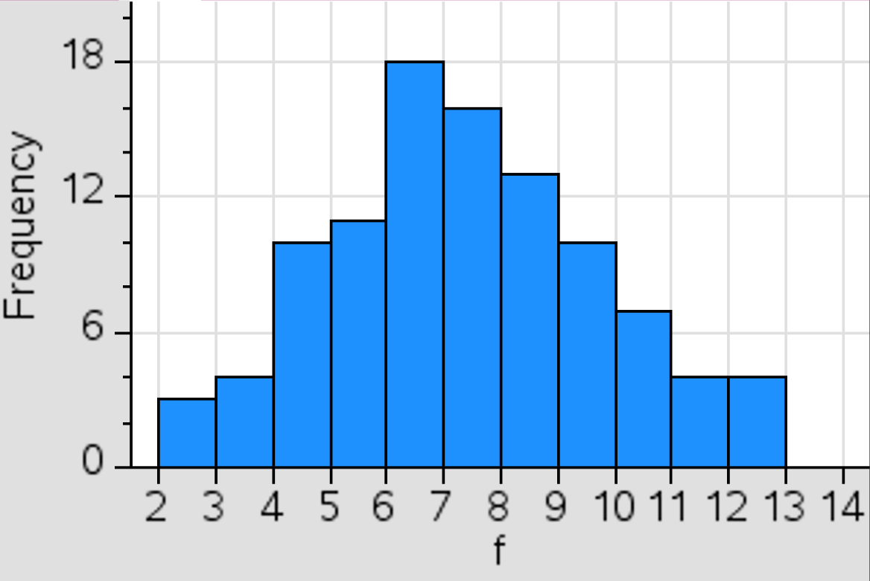
Analyze the Results
Menu -> 1 Plot Type -> 3 Histogram

Slide 43
Next Steps

Slide 44
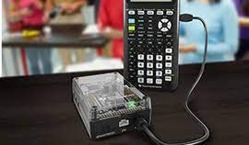
What Next?
Sound or light on die roll
Light sensor triggers die roll with Innovator Hub

Slide 45
Simulating Dice With Python on the TI-Nspire™ CX II Graphing Calculator
Chris Atkinson

Slide 46
Thank You
Chris Atkinson

