Slide 1
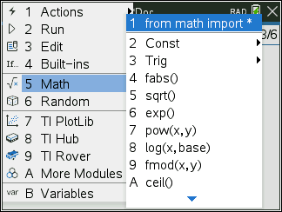
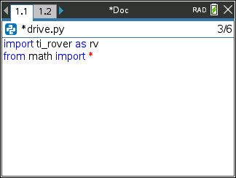
Logic Challenge 2
Task: Drive the figure shown without crossing any lines or going back over a line and without picking up the pen.
When you are ready put the pen in and trace your path
Import the Python Math module in addition to the Rover module for this challenge.
Notes:
We will need to import the math library
First challenge is to drive the shape without crossing any lines and without picking up the pen.
Second will be to drive at least one segment in reverse direction.

Slide 2
TI NSPIRE CX II - PYTHON

Slide 3
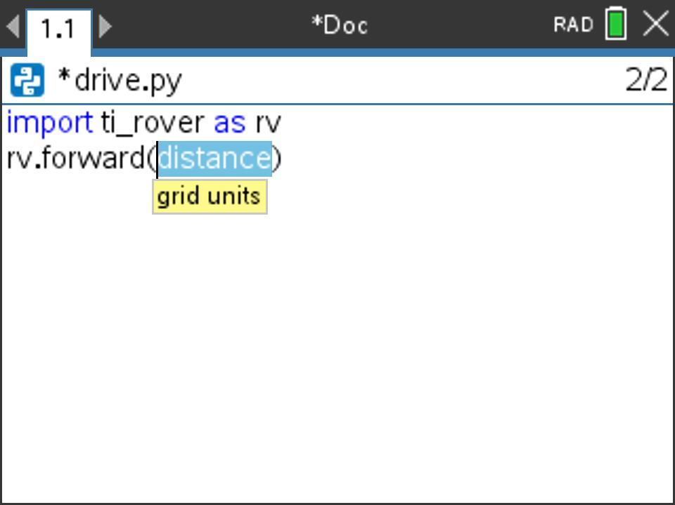
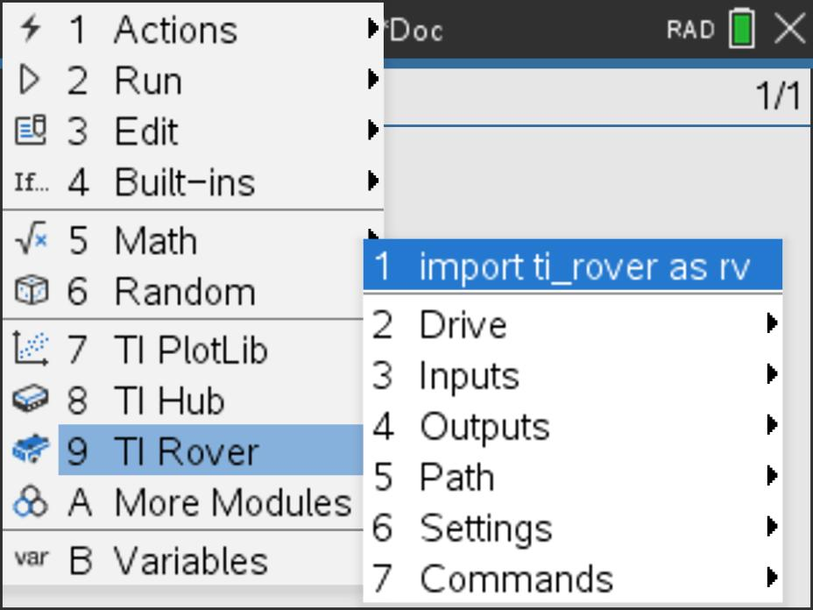
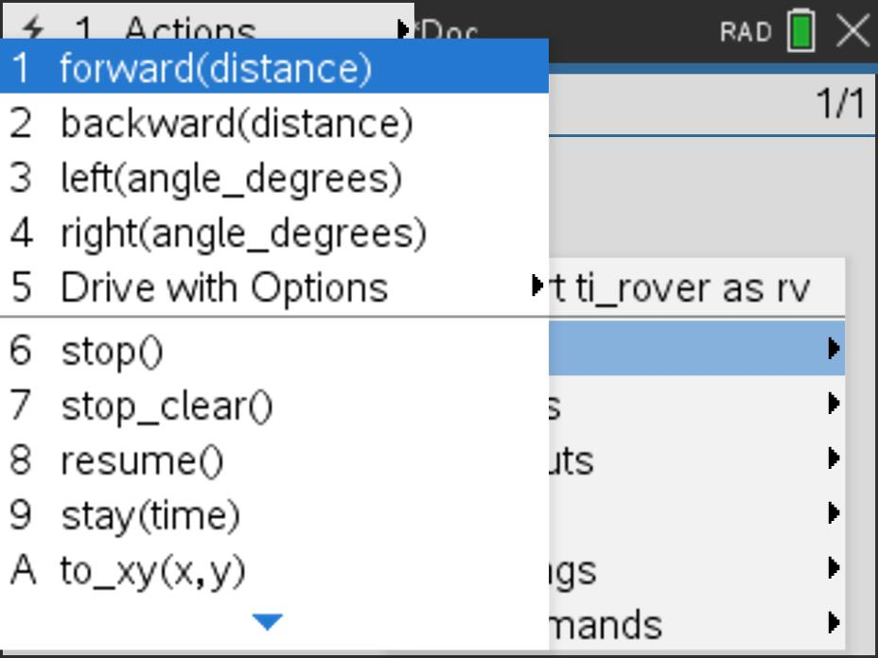
MAKE IT MOVE!
New Program:
Task: Discover how far Rover drives per unit.
Use differing values (1-20) to determine what 1 Rover unit is.
Find import ti_rover on the TI Rover menu.
Find forward() and other drive functions on the Rover 2:Drive menu.
Press [menu] key to see Python Program Editor options.
Press [ctrl] [R] to run the program from a Python shell on the next page.
Use [ctrl] left to move from the shell page back to the Python editor page.
Notes:
Explain import ti_rover module
Then demo how to import and how to enter the statements.
Give students time to explore with different distances to figure out.
Use [ctrl] left and [ctrl] right to move from page to page in the document.

Slide 4
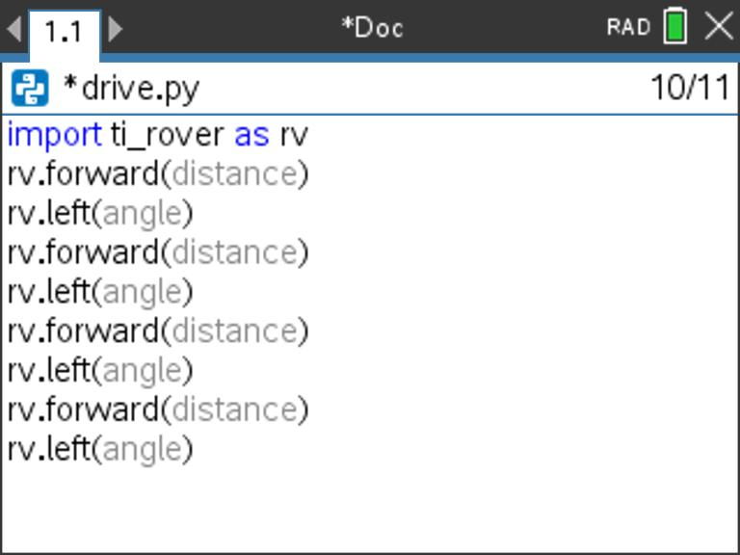
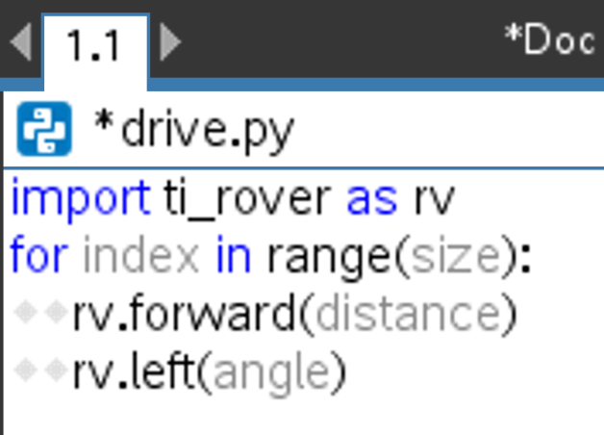
Explore angles
Task: Drive a square.
Challenge Task: Try to drive an equilateral triangle.
New Program:
The program above is a framework for driving a square. Enter values for distance and turn angle.
Press [menu] key to see Python Program Editor options.
for loops can be found in:
Press [ctrl] [R] to run the program from a Python shell on the next page. Menu -> 4 Built Ins -> 2 Control
Use [ctrl] left to move from the shell page back to the Python editor page.
Notes:
Explain import ti_rover module
Then demo how to import and how to enter the statements.
Give time to explore.

Slide 5
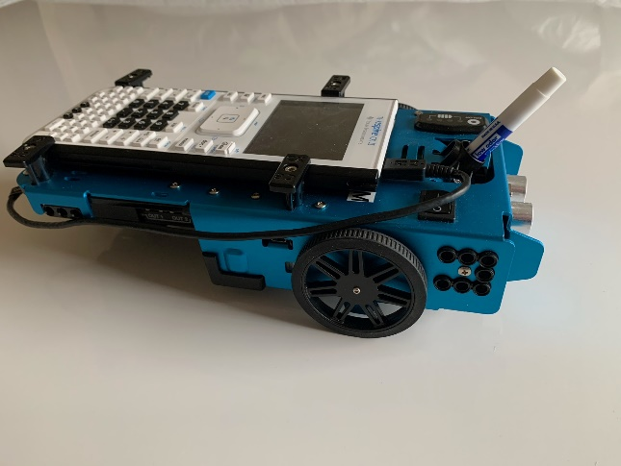
Logic Challenge
Task: Drive the figure shown without crossing any lines or going back over a line and without picking up the pen.
When you are ready put the pen in and trace your path
Notes:
First challenge is to drive the shape without crossing any lines and without picking up the pen.

Slide 6

Logic Challenge
Task: Drive the figure shown using the drive to_xy command.
When you are ready put the pen in and trace your path
Notes:
First challenge is to drive the shape without crossing any lines and without picking up the pen.

Slide 7
TI NSPIRE CX - BASIC

Slide 8
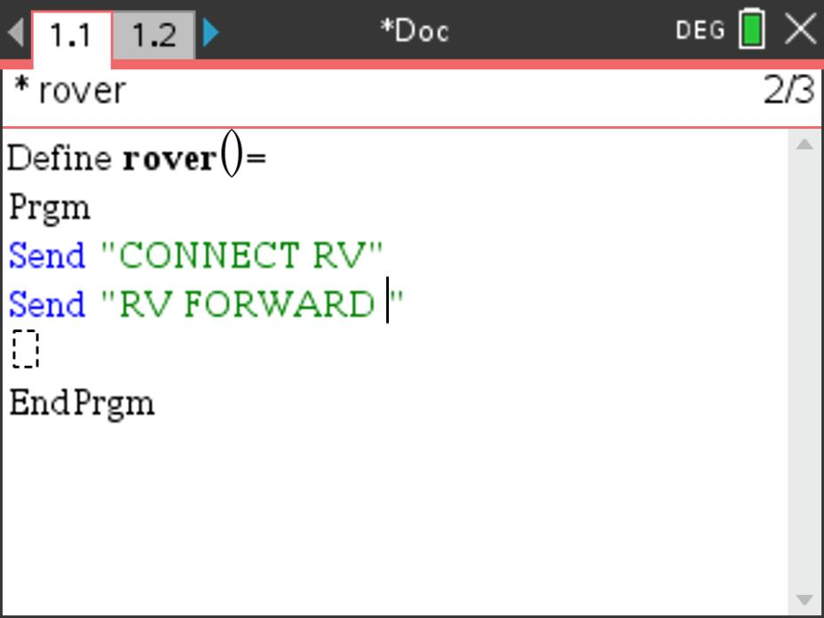
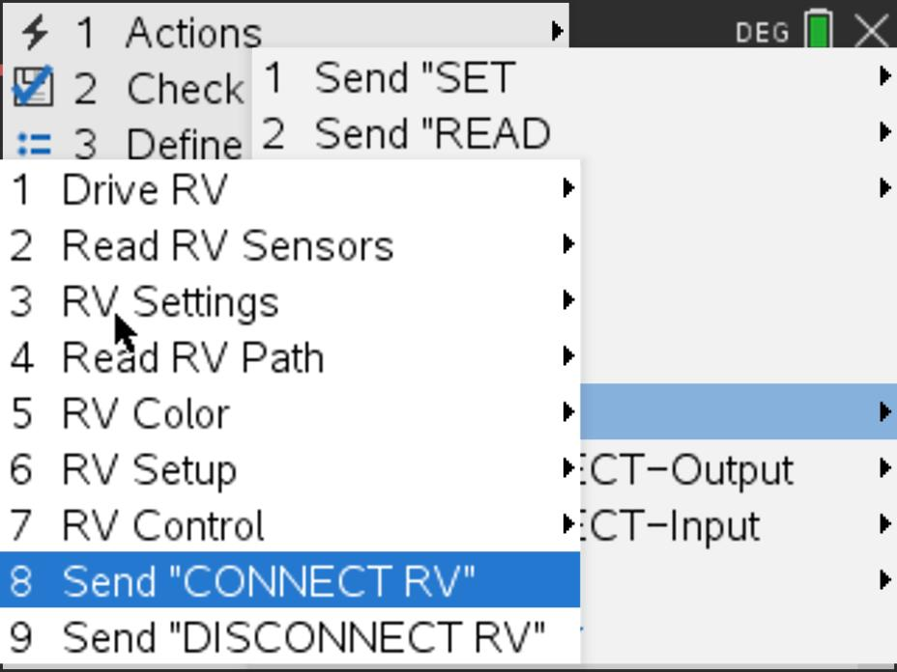
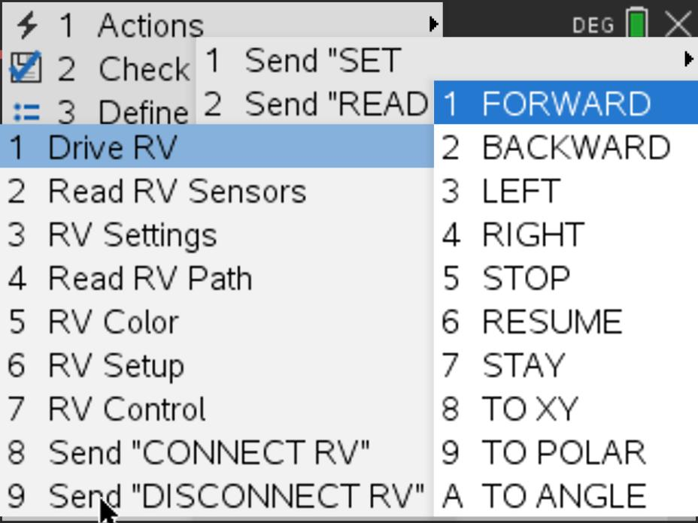
MAKE IT MOVE!
New Program:
Task: Discover how far Rover drives per unit.
Use differing values (1-5) to determine what 1 Rover unit is.
Find ”CONNECT RV” on the 8:Hub>7:Rover menu.
Find FORWARD on the 8:Hub>7:Rover>1:Drive RV menu.
Enter value for number of units to drive.
Right arrow to the end of the line and press [enter] to complete the command and move to the next line.
Press [menu] key to see TI-Basic Program Editor options.
Press [ctrl] [R] to paste the program name ready to run in a Calculator app on the next page. Press [enter] in the Calculator app to run the program.
Use [ctrl] left to move from the Calculator page back to the editor page.
Notes:
Explain “Connect RV”
Then demo how to add Send “CONNECT RV” to the first line in the program.
Give students time to explore with different distances to figure out.
Use [ctrl] left and [ctrl] right to move from page to page in the document.

Slide 9
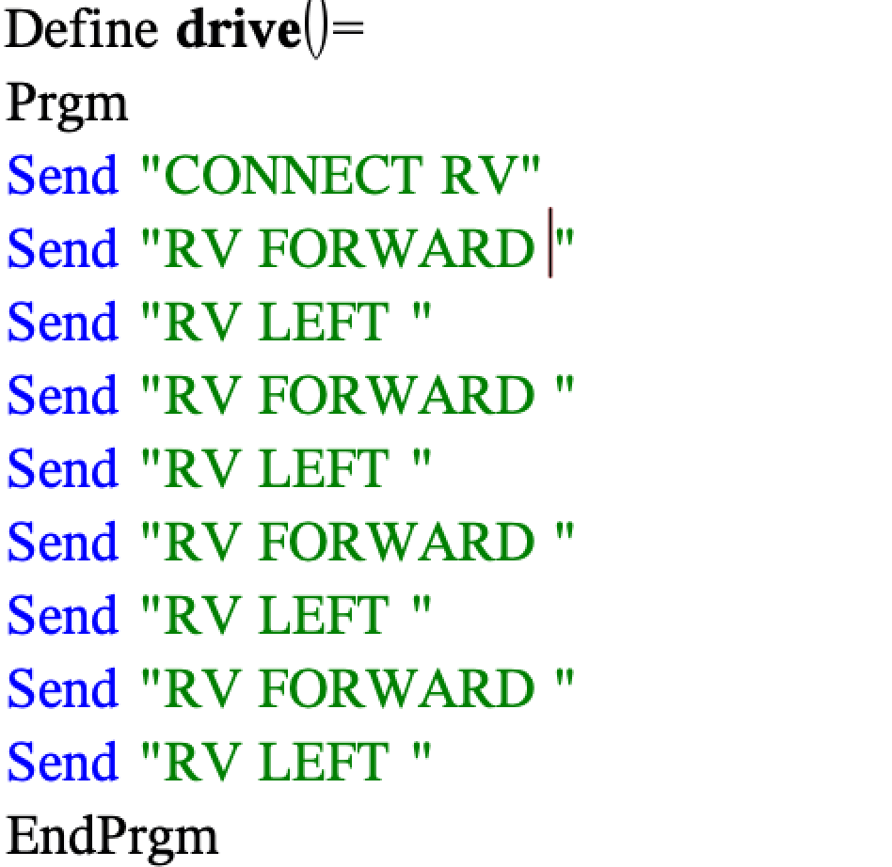
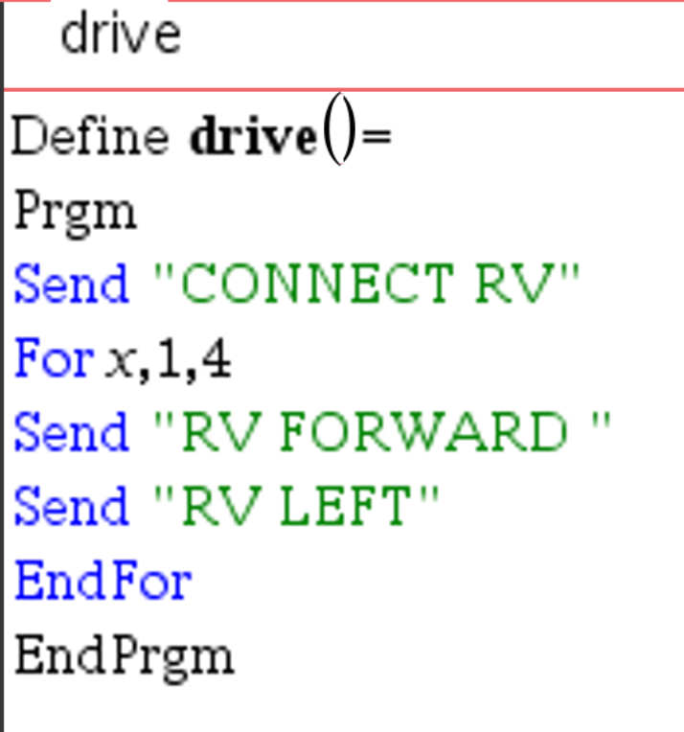
Explore angles
New Program:
Task: Drive a square.
Challenge Task: Try to drive an equilateral triangle.
The program above is a framework for driving a square.
Enter values for distance and turn angle.
Notes:
Explain import ti_rover module
Then demo how to import and how to enter the statements.
Give time to explore.

Slide 10
Logic Challenge
Task: Drive the figure shown without crossing any lines or going back over a line and without picking up the pen.
When you are ready put the pen in and trace your path
Notes:
First challenge is to drive the shape without crossing any lines and without picking up the pen.

Slide 11

Logic Challenge
Task: Drive the figure shown using the drive to_xy command.
When you are ready put the pen in and trace your path
Notes:
First challenge is to drive the shape without crossing any lines and without picking up the pen.

Slide 12
TI 84 CE - BASIC

Slide 13
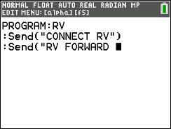
MAKE IT MOVE!
New Program:
Task: Discover how far Rover drives per unit.
Use differing values (1-20) to determine what 1 Rover unit is.
Enter a value for the number of grid units to drive forward.
Finish the command by entering
the number of units to drive,
then close the command with
alpha quotes (plus key) and and close paren ) followed by
[enter] to move to the next line.
Notes:
Give students time to explore with different distances to figure out.

Slide 14
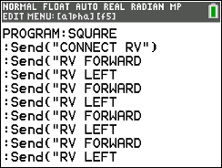
Explore angles
New Program:
Task: Drive a square.
Challenge Task: Try to drive an equilateral triangle.
Enter values for forward drive distance and turn angle.
Close the commands with alpha quote (plus key) and
close paren ) followed by [enter] to move to the next line.
The program above is a framework for driving a square.
Enter values for distance and turn angle.

Slide 15
Logic Challenge
Task: Drive the figure shown without crossing any lines or going back over a line and without picking up the pen.
When you are ready put the pen in and trace your path
Notes:
First challenge is to drive the shape without crossing any lines and without picking up the pen.

Slide 16

Logic Challenge
Task: Drive the figure shown using the drive to_xy command.
When you are ready put the pen in and trace your path
Notes:
First challenge is to drive the shape without crossing any lines and without picking up the pen.

